Slide 1
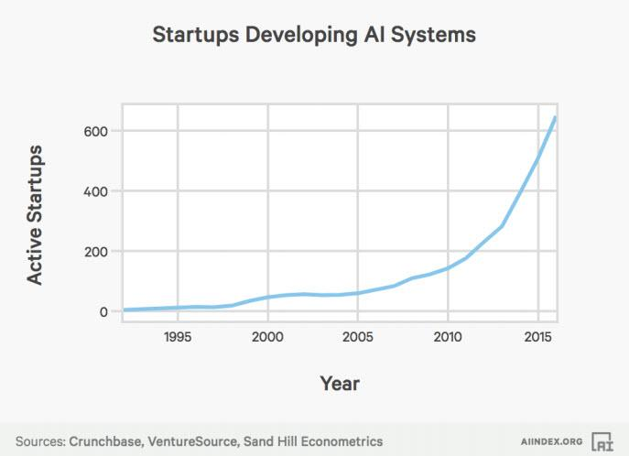
Business impact of AI and deep learning
There has been a 14X increase in the number of active AI startups since 2000:
Crunchbase, VentureSource, and Sand Hill Econometrics were also used for completing this analysis with AI startups in Crunchbase cross-referenced to venture-backed companies in the VentureSource database. Any venture-backed companies from the Crunchbase list that were identified in the VentureSource database were included.

Slide 2
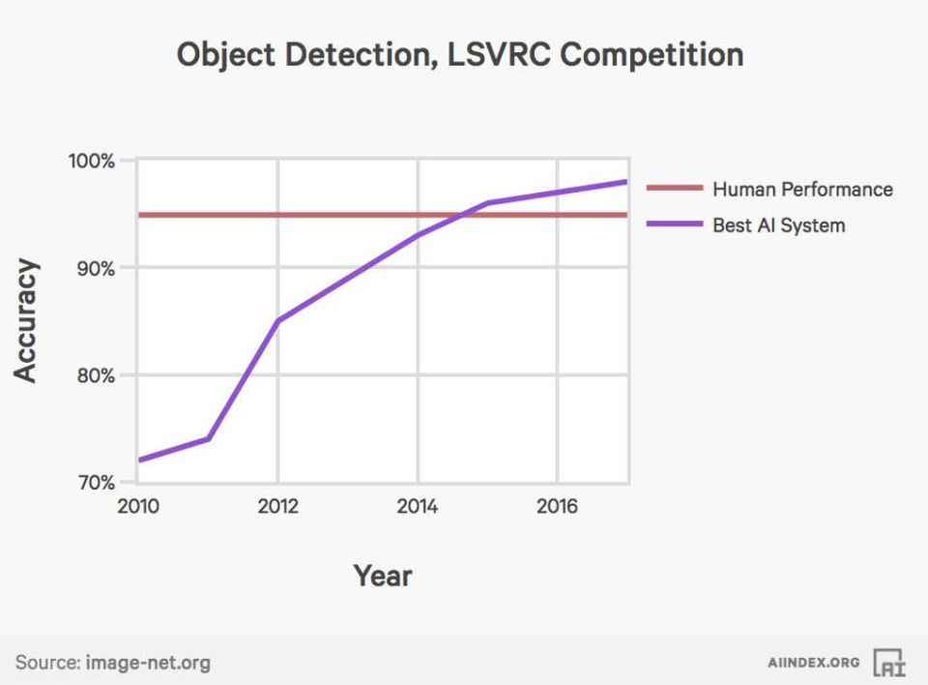
Business impact of AI and deep learning
Error rates for image labeling have fallen from 28.5% to below 2.5% since 2010
AI’s inflection point for Object Detection task of the Large Scale Visual Recognition Challenge (LSVRC) Competition occurred in 2014. On this specific test, AI is now more accurate than human These findings are from the competition data from the leaderboards for each LSVRC competition hosted on the ImageNet website.

Slide 3
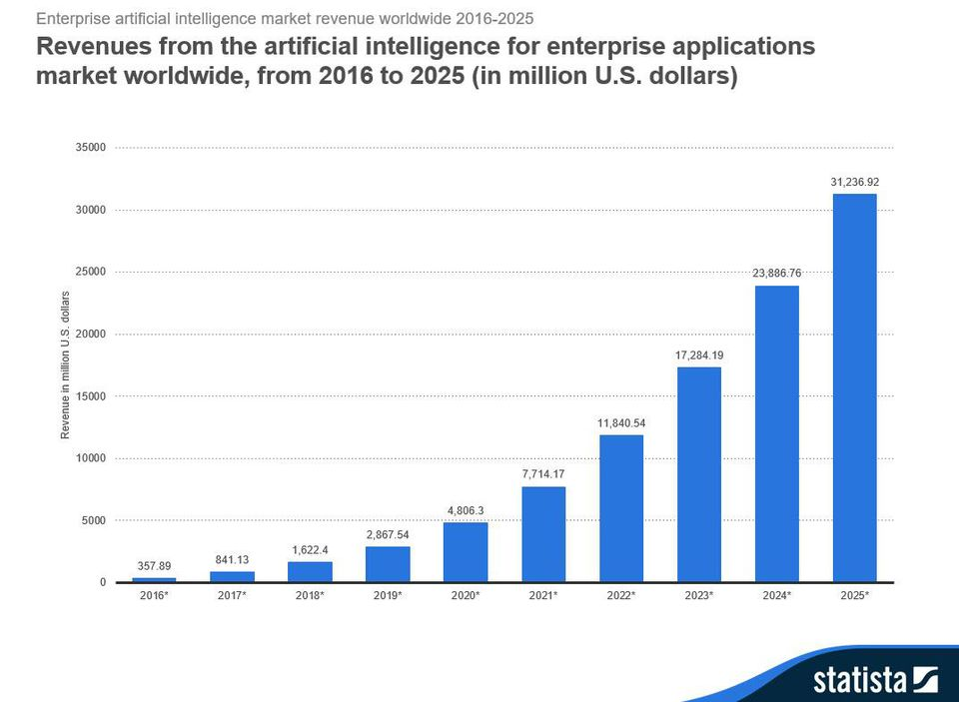
Business impact of AI and deep learning
Global revenues from AI for enterprise applications is projected to grow from $1.62B in 2018 to $31.2B in 2025 attaining a 52.59% CAGR in the forecast period.
Image recognition and tagging, patient data processing, localization and mapping, predictive maintenance, use of algorithms and machine learning to predict and thwart security threats, intelligent recruitment, and HR systems are a few of the many enterprise application use cases predicted to fuel the projected rapid growth of AI in the enterprise. Source: Statista.

Slide 4
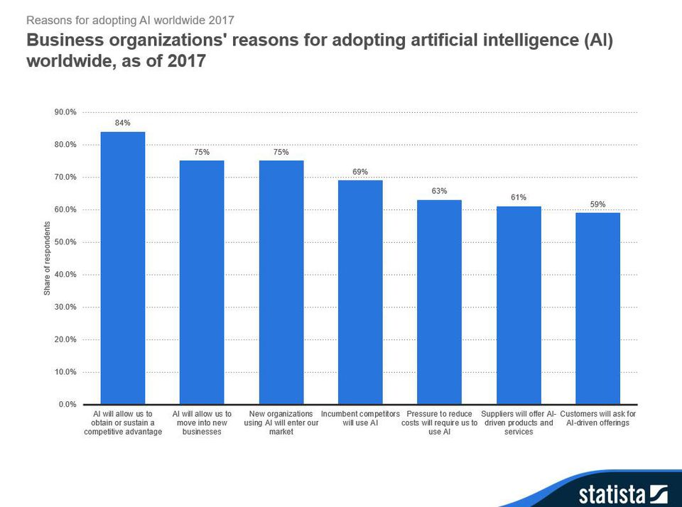
Business impact of AI and deep learning
84% of enterprises believe investing in AI will lead to greater competitive advantages
75% believe that AI will open up new businesses while also providing competitors new ways to gain access to their markets. 63% believe the pressure to reduce costs will require the use of AI. Source: Statista.

Slide 5
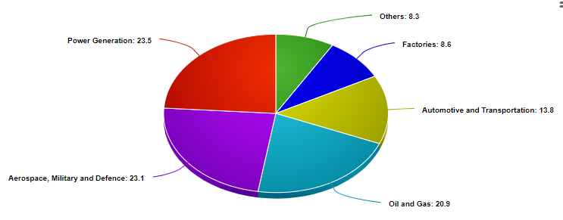
Business impact visual inspection tool in industries
Among the many industries where visual inspection is required, there are several where visual inspection is considered to be of very high consequence and is high priority activity due to the potentially high cost of any errors that may arise via inspection such as injury, fatality, loss of expensive equipment, scrapped items, rework, or a loss of customers. Such fields where visual inspection is prioritised include nuclear weapons, nuclear power, airport baggage screening, aircraft maintenance, food industry, medicine and pharmaceuticals.

Slide 6
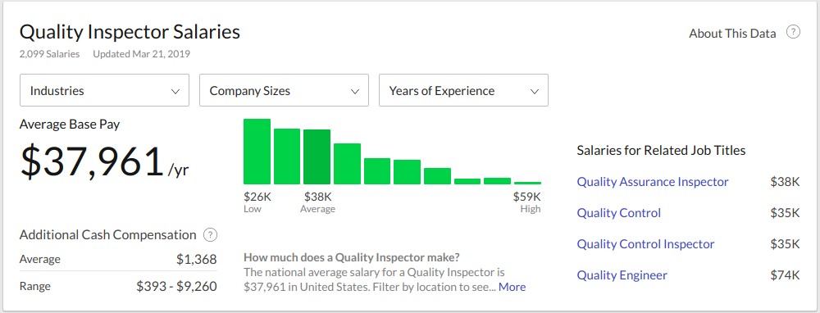
Business impact visual inspection tool in industries
Cost of labour
Manual inspection remains a costly venture due to the appointment of (multiple) trained individuals. Cost-wise, manual inspection operators may be earning a yearly salary of $50,000 to $60,000.

